Slide 1
CS792–Group#4 ReadmissionAnalyzer
Prashanth T.K.
Ritik Arora
Sriram Gowrishankar

Slide 2
READMISSION ANALYZER AGENDA
The Hospital Readmissions problem
The Difficulty of Patient Risk stratification
Predicting Readmissions
ReadmissionAnalyzer Platform

Slide 3
It’s a beautiful day to talk Population Health[1]
– Dr. David Levin
Notes:
The 5 step model describing every strong population health program includes:
Identify (the target population) based on Clinical Comorbidity
Stratify (the population based on risk) – Using LACE Index or a predictive model
Engage (patients, families, community & clinicians) – using Care transition documents
Intervene (in the right way with different segments of the population)
Measure (against the expected clinical and programmatic results)
Reference
[1] - Amati Health. (2015, June 03). Population Health Methodology, Step 2: Stratification. Retrieved March 30, 2018, from http://amatihealth.com/blog/2015/6/3/population-health-methodology-step-2-stratification

Slide 4
1.
Avoidable Hospital Readmissions
Definitions
Readmission
Time Interval
Avoidable Readmission
Comorbidity
Notes:
Readmission is not just a word or a single process. Its an entire situational problem in itself.
1. Readmission - A readmission is a return hospitalization to an acute care hospital that follows a prior admission from an acute care hospital.
2. Readmission time interval - The readmission time interval is the maximum number of days
allowed between the discharge date of a prior admission and the admit date of a subsequent admission in order for the subsequent admission to be a readmission. In the United States, CMS has identified this interval as 30 days and it is widely adopted by most healthcare jurisdictions worldwide.
3. Avoidable Readmission -return hospitalization within the specified readmission time interval which is 30 days) that is clinically-related (as defined below) to the initial hospital admission.
4. Comorbidity –is a requirement that the underlying reason for readmission be plausibly related to the care rendered during or immediately following a prior hospital admission.
Reference
Potentially Preventable Readmissions Classification System – 3M Methodology Overview
https://www.illinois.gov/hfs/SiteCollectionDocuments/3MPotentiallyPreventableReadmissions.pdf

Slide 5
AVOIDABLE READMISSIONS PROBLEM
Hospitalizations consume 31% of $2T in healthcare costs in the USA.
Avoidable
Is 1 in 4, 25% of hospitalizations in the U.S. are deemed avoidable with efforts made during the initial admission [2]
Readmissions
Preventable hospital readmissions cost the U.S. health care system an estimated $25 billion annually [3]
Notes:
The Avoidable Readmissions Problem
In a study of 12 academic medical centers nationwide, researchers examined 1,007 readmissions occurring within 30 days of discharge, interviewed patients and their doctors, and scoured medical records.
Their review found that 27% of readmissions were considered preventable. More than half (52%) of those preventable readmissions could have been avoided "with efforts made during the initial admission," the study says.
836,000, or 12 percent, of the more than 7 million 30-day hospital readmissions that occur in the U.S each year are actually preventable
Reference
[2] - Auerbach AD, Kripalani S, Vasilevskis EE, et al. Preventability and Causes of Readmissions in a National Cohort of General Medicine Patients. JAMA Intern Med.2016;176(4):484–493. doi:10.1001/jamainternmed.2015.7863
[3] - PriceWaterhouse Coopers’ Health Research Institute. (2008). The Price of Excess: Identifying Waste in Healthcare, 2008. Retrieved from http://www.pwc.com/us/en/healthcare/ publications/the-price-of-excess.jhtml. Last accessed October 2011.

Slide 6
AVOIDABLE READMISSIONS - CONTRIBUTING FACTORS
Index Stay
Sub-optimal management of the prevalent clinical condition and insufficient care-pathway prediction [4]
Discharge Process
Incomplete discharge planning, poor care transition and coordination and un-addressed psychological and social needs [4]
Follow-up Care
Failure to adjust the care management plan to better meet patient needs. [4]
Notes:
Some of the Likely Causes for avoidable readmissions are
When Patients experience preventable medical errors and complications during the first hospital stay.
Sometimes Patients have limited or no access to effective post-hospital follow-up care (e.g. rehabilitation) in their communities.
Patients and their families are inadequately informed about appropriate post-discharge care.
In some cases, Hospital records and discharge instructions are not effectively and efficiently disseminated to primary care clinicians and other post-discharge care providers to support the patient’s recovery.
Patients who are Readmitted also follow a common pattern.
Preventable readmission rates are highest among patients with heart failure, COPD, psychoses, intestinal problems and/or those who have had various types of surgery (cardiac, joint replacement or bariatric procedures).
References
[4] - Jencks, S., Williams, M., & Coleman, E. (2009). Rehospitalizations among Patients in the Medicare Fee-for-Service Program. Journal of Vascular Surgery, 50(1), 234. doi:10.1016/j.jvs.2009.05.045

Slide 7
2. PREDICTING READMISSIONS
A $25B Opportunity
Notes:
Targeting the $25 billion spent annually on preventable hospital readmissions requires building on proven practices and implementing policy actions that target the root causes of the problem.
Reference
[5] - New England Healthcare Institute (NEHI), How Many More Studies Will It Take? A
Collection of Evidence That Our Health Care System Can Do Better, Cambridge, MA:
NEHI, 2008. Available at www.nehi.net/publications/30/how_many_more_studies_will_it_take.
Last accessed November 2010.

Slide 8
PREDICTING READMISSIONS
Question
How can patients who are at high risk of being readmitted be identified so that further readmissions can be avoided by enhancing the discharge process?
Solution
The answer to this question is through the use of predictive models to flag patients at risk for readmission
To build a generalized 30-day predictor of hospital readmissions.
Clinical Comorbidity specific predictor (19 Total)
Notes:
Addressing this question, Reducing readmission rates through improved care transitions between accountable care organizations (ACO’s) requires an evidence-based approach that incorporates adequate communication, optimized workflows and institutional commitment to improving patient outcomes. This can be achieved by using profiling and predictive analysis systems to identify patients at high risk for readmissions and connect them to additional discharge support. The sequence of steps include
First, Identifying patients at high risk for re-hospitalization
Then, specific interventions to mitigate potential adverse events are developed
Thereby reducing 30-day readmission rates
Reference
[6] - Society of Hospital Medicine. Project BOOST: Care Transitions Implementation Guide. Philadelphia, PA. Retrieved from http://www.hospitalmedicine.org/ResourceRoomRedesign/RR_CareTransitions/CT_Home.cfm.

Slide 9
PREDICTING READMISSIONS
Opportunity Assessment
Increased ability to perform meaningful investigation on factors related to readmission.
Potential $$$ saved from more efficient reporting.
Provides a foundation for further investigation into factors that contribute to readmissions
Analysis focused on specific cohorts of patients
Notes:
Because of the abundance of data in hospitals, meaningful analysis can be performed to derive insight.
There are also a lot of financial benefits from solving this problem.

Slide 10
PREDICTING READMISSIONS
1 Screen Patients to Identify independent risk factors
3 Use Business Intelligence to drive resource/capacity interventions
4 Continual Model assessment and validation
2 Apply risk Stratification methods to classify risk (Lace Index, Comorbidity Predictor)
Notes:
An ideal Clinical Prediction Models has the following characteristics
It Needs access to clinical data sets that can be reliably obtained
Its Deployable in large populations
The model uses Variables clinically related to the target population
Data is provisioned before discharge
The model should discriminate patients as high risk vs low risk
The model should Not overly complex and be easily deployable for large population cohorts

Slide 11
PREDICTING READMISSIONS – LACE INDEX[7]
LACE
INDEX
Four variables are independently associated with unplanned readmissions within 30 days.
Length of stay.
Acuity of the admission.
Comorbidities using the Charlson comorbidity index.[8]
Emergency room visits in the past 6 months.
Notes:
LACE Index
Dr Carl van Walraven et al., looked at 48 patient-level and admission level variables for 4812 patients discharged form 11 hospitals in Ontario. Four variables were independently associated with unplanned readmissions within 30 days. The Baseline readmission rates were determined to be only about 7%
Used to quantify risk of death or unplanned readmission within 30 days after discharge from hospital.
Was proven to be discriminative (C statistic 0.684) and quite accurate (p = 0.59) at predicting outcome risk. Model discrimination is better than previous models and has been externally validated
The Score can be calculated in real-time during hospitalization
Charlson Comorbidity Index
Based on administrative data uses presence or absence of 17 comorbidity definitions
Used to predict the risk of one-year mortality for patients with a range of comorbid illnesses
assigns patients a score from one to 20, with 20 being the more complex patients with multiple comorbid conditions
References
[7] – Van Walraven, C., Dhalla, I. A., Bell, C., Etchells, E., Stiell, I. G., Zarnke, K., … Forster, A. J. (2010). Derivation and validation of an index to predict early death or unplanned readmission after discharge from hospital to the community. CMAJ : Canadian Medical Association Journal, 182(6), 551–557. http://doi.org/10.1503/cmaj.091117
[8] – Charlson, M. E., Pompei, P., Ales, K. L., & Mackenzie, C. (1987). A new method of classifying prognostic comorbidity in longitudinal studies: Development and validation. Journal of Chronic Diseases, 40(5), 373-383. doi:10.1016/0021-9681(87)90171-8

Slide 12
ADAPTING LACE INDEX TO CLINICAL COMORBIDITIES
LACE
INDEX
LACE INDEX SCORE
Adapted Patient Readmission Risk Score
Gender
Age Category
Ethnicity
Insulin Level
Diabetes Medication (High Risk)
Notes:
Readmission Prediction for Diabetes patients
In addition to calculating the LACE Index for every patient, we could adapt the LACE Index for clinical use by considering the clinical factors for specific comorbidities, for example Diabetes. These factors could include
Patient Demographics – Age, Gender, Ethinicity
High Risk Medications – Anti-coagulants, diabetic meds ..etc
Clinical Risk factors – Insulin Levels, Blood Pressure ..etc

Slide 13
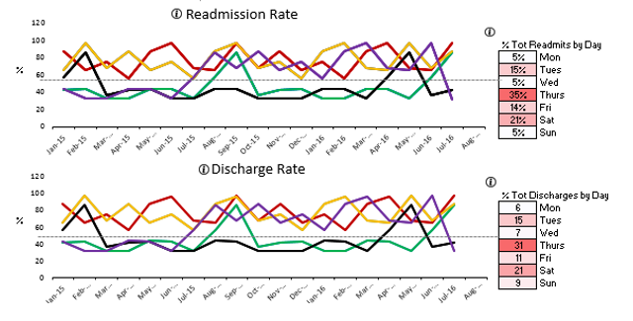
READMISSION ANALYZER
One-Stop shop to Predict, Analyze, Trend Readmission risk for admitted inpatients
Notes:
ReadmissionAnalyzer
ReadmissionAnalyzer will be the unique provider of a range of real-time patient risk stratification applications focusing specifically on decision support capabilities for reporting on acute-hospital in-patient characteristics via cloud-based desktop application for participating government health agencies, health system payers and practitioners.
ReadmissionAnalyzer will facilitate insight into improving patient and process outcomes for chronic disease management, continuous patient monitoring for readmission risk, care transitioning to extended health facilities and to inform the design of health policy readmission reduction initiatives to target specific population clusters.

Slide 14
The READMISSION ANALYZER Tool
Predictions and Analysis using Actual Patient Data
Q1. To make predictions where do we get our data ?
Q2. What exactly is a readmission ?
Q3. What is the technology stack of the tool ? What is the back-end and front-end ?
Notes:
We obtained 10 years worth of actual data on patients and their medications during medical encounters in 130 hospitals in USA.
We preprocessed the data and hosted it as an SQL database for easy and quick patient record retrieval. --> (Back-End)
We trained an ML model leveraging the widely used Amazon Web Sservices to predict whether a currently admitted patient is under the risk of being readmitted within the next 30 days.
Features: Demographic, Medical info and previous admission history. Gender, ethnicitity , Age category, number of medications or Whether the patient is taking medication like Metformin,
We provide support LACE score and non-LACE score based risk stratification through Machine Learning in health informatics.
Users can filter admissions in real-time to examine high risk patients and underlying patterns amongst readmitted patients using our simple and easy-to-use web interface --> (Front-End)

Slide 15
READMISSION ANALYZER - COMPONENTS
PRRS
(Risk Stratification)
PRBI
(Business
Intelligence)
PRRC
(Root Cause Analysis)
PRRS
scores a hospital in-patient on a scale of (1-10) for readmission probability based on the LACE index
PRBI
enable business intelligence on Readmission metrics via time-series reporting and trending services
PRRC
help health care providers understand the contributing factors and likely cause for patient risk
Notes:
There are 3 components to our ReadmissionAnalyzer platform
The product offering includes Patient-Readmission Risk Stratification tool, Readmission Root Cause Management tool and Patient Readmission Business Intelligence tool. The tool is primarily meant to leverage the outbound discharge reporting services also known the Discharge Abstract Database (DAD), currently supported by most commercial EHR’s and mandated by CIHI. Since the metadata schematics of the DAD are public, ReadmissionAnalyzer can reuse this information and this approach is minimally invasive from a systems integration viewpoint.
Patient-Readmission Risk Stratification (PRRS) tool – This tool scores a hospital in-patient on a scale of (1-10) for readmission probability based on the LACE index, an assessment instrument designed to identify patients who are at risk for readmission or death within thirty days of discharge, is based on four factors.
Patient-Readmission Root Cause (PRRC) Identification tool - This tool will help health care providers understand the contributing factors and likely cause for patient risk.
Patient Readmission Business Intelligence (PRBI) tool – This tool will enable business intelligence and time-series based trending capabilities to view/trend aggregated readmission scores, slicing/dicing this information using clinical dimensions.

Slide 16
READMISSION ANALYZER
Benefits
Highlight trends associated with readmissions and identify areas where readmissions could be reduced.
Users can filter on index admissions (LACE score) and/or readmission conditions
Supports root-cause analysis of specific clinical comorbidities: Diabetes, AMI, CHF, Pneumonia, Total Hip/Total Knee and COPD.
Patient level what-if scenario builder
Notes:
This is just a summary of the core benefits of using our framework.

Slide 17
APPENDIX

Slide 18
APPENDIX A - LACE INDEX
Appendix-A
Study Design
Multicenter, prospective cohort study (Oct 2002 – July 2006)
Included 11 hospitals (6 university-affiliated, 5 community) in Ontario, Canada
Outcomes Evaluated
Risk of death or unplanned readmission within 30 days post discharge
Methods
Patient interviews pre- and post-discharge, and manual chart review
Split-sample design to derive and validate an index to predict risk of death.

Slide 19
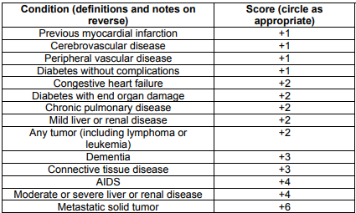
APPENDIX A - LACE INDEX
Appendix-A
Comorbidity Weighting
Notes:
Reference
http://micmrc.org/system/files/LACE_tool%204.23.13.pdf

Slide 20
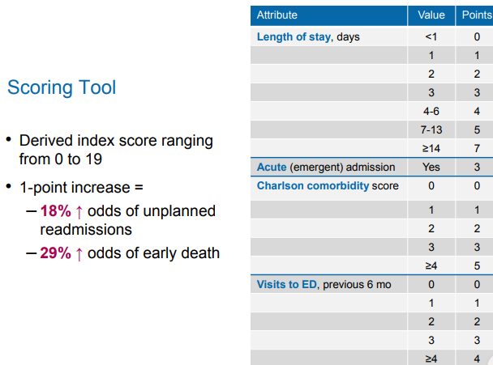
APPENDIX A - LACE INDEX
Appendix-A
LACE Score > 10 → High Risk Readmission

Slide 21
APPENDIX B – DIABETES DATA SET (PUBLIC)
Appendix-B
UCI Diabetes Data Set
Maintained by University of California, Irvine (UCI)
consists of 101,766 rows and represents 10 years of clinical care records from 130 US hospitals and integrated delivery networks.
includes over 50 features (attributes) representing patient and hospital
Encounter Selection Criteria
An Inpatient encounter (Hospital Admission)
An Diabetic encounter, diabetes was entered to the system as a diagnosis
The length of stay was at least 1 day and at most 14 days
Medications were administered during the encounter.
Notes:
The data contains such attributes as patient number, race, gender, age, admission type, time in hospital, medical specialty of admitting physician, number of lab test performed, HbA1c test result, diagnosis, number of medication, diabetic medications, number of outpatient, inpatient, and emergency visits in the year before the hospitalization, etc.
Link: https://archive.ics.uci.edu/ml/datasets/Diabetes+130-US+hospitals+for+years+1999-2008

Slide 22
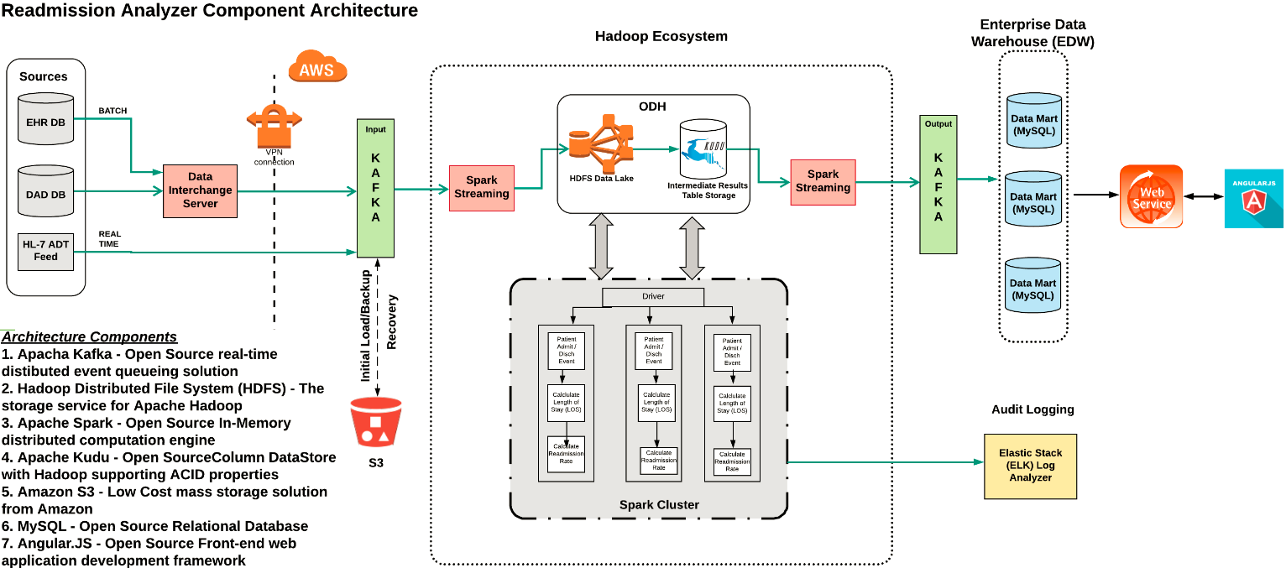
APPENDIX D – TECHNICAL ARCHITECTURE (PROPOSED)
Appendix-D
Notes:
The data contains such attributes as patient number, race, gender, age, admission type, time in hospital, medical specialty of admitting physician, number of lab test performed, HbA1c test result, diagnosis, number of medication, diabetic medications, number of outpatient, inpatient, and emergency visits in the year before the hospitalization, etc.
Link: https://archive.ics.uci.edu/ml/datasets/Diabetes+130-US+hospitals+for+years+1999-2008

Slide 23
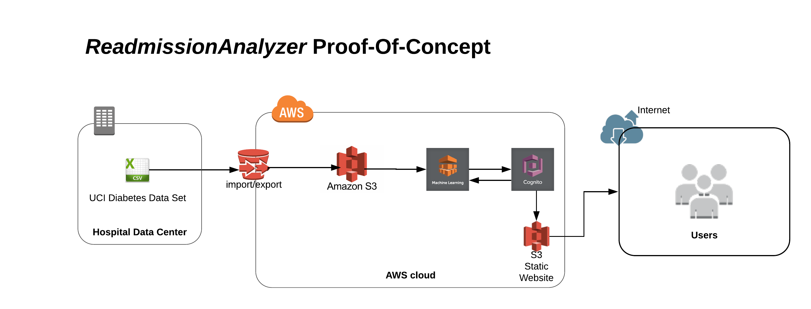
APPENDIX D – TECHNICAL ARCHITECTURE (DEMO)
Appendix-C
Notes:
The first step is to get the data into Amazon S3, the object storage service from AWS. Amazon S3 acts as the file system storage service for the huge amounts of structured clinical data. The data is loaded as-is into a pre-determined structure and is massaged using Amazon Relational Database Service to make it more meaningful as a data source for an ML model. It also provides a relational database for querying patient data.
A binary classification ML model is created using Amazon ML, with Amazon S3 as the data source. A real-time endpoint is also created to allow real-time querying for the ML model. ( For demo purposes, we will be querying from a local postgreSQL instance of the same database).
Amazon Cognito could be used for secure federated access to the Amazon ML real-time endpoint.
A static web site is created on S3. This website hosts the end user facing application using which one can query the Amazon ML endpoint in real time.

Slide 24
THANKS!
Any questions?

